Slide 1


ACTION TO IMPROVE PUBLIC SCHEME ACCESS AND DELIVERY (AIPAD)
Project Duration : 48 months
Reporting Period : 1st January 2014 – 30th April, 2015
Location : Bhagalpur, Bihar

Slide 2
KEY SCHEMES:
National Health Mission
Swachh Bharat Abhiyaan
ICDS
Sarva Shiksha Abhiyaan
Pradhan Mantri Jan Dhan Yojana
Pension schemes for the Widows, Aged, Disabled and Artisans
Rashtriya Swasthya Bima Yojana
TARGET POPULATION
Rural communities in multiple blocks in the district of Bhagalpur (especially women, girl children and unorganized workers) Panchayati Raj Institution members, government.
Approximately 10,00,000 people residing in 105 Gram Panchayats in the district of Bhagalpur, Bihar will benefit directly through the Action.

Slide 3
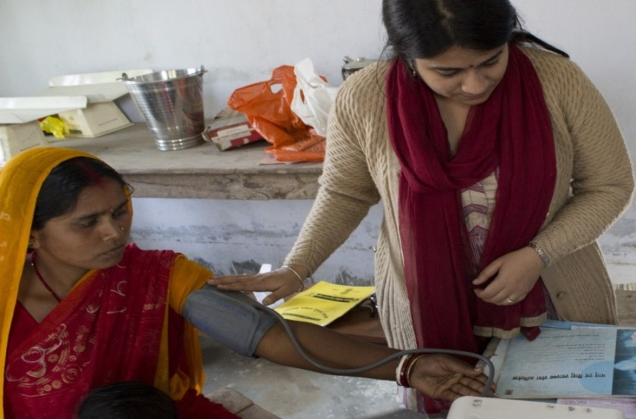
HEALTH ACTIVITIES
Vaccine | Number of children immunized (approx.)
BCG | 34000
DPT | 37000
Measles | 29000
Hepatitis B | 35000
Japanese Encephalitis | 10000
Polio | 37000
TT (Tetanus-only for pregnant women) | 22000

Slide 4
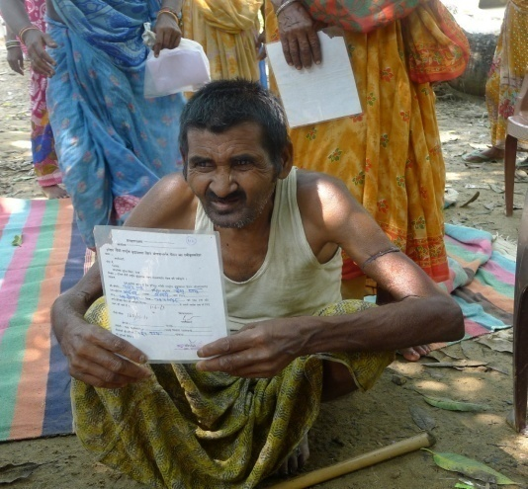
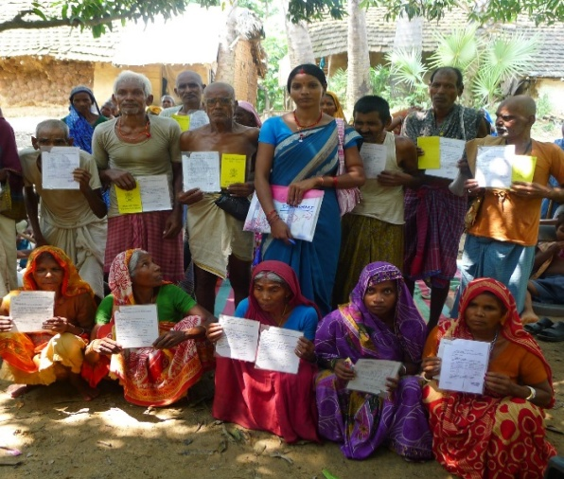
SOCIAL SECURITY ACTIVITIES
The AIPAD team has succeeded in opening 6004 bank accounts under the Jan Dhan Yojana in 4 blocks of Bhagalpur in Bihar. The team has achieved this feat in just 3 months.
Cumulative number of people benefitted with AIPAD’S effort in social security schemes across the 5 blocks:
Block | Total number of eligible persons benefitted
Kahalgaon | 640
Shahkund | 2250
Pirpainti | 1270
Jagdishpur | 1844
Total | 6004
Social Security Schemes | No. of people benefitted
Widow Pension | 96
Old Age Pension | 88
Disability Pension | 115
Shatabdi Scheme | 7

Slide 5
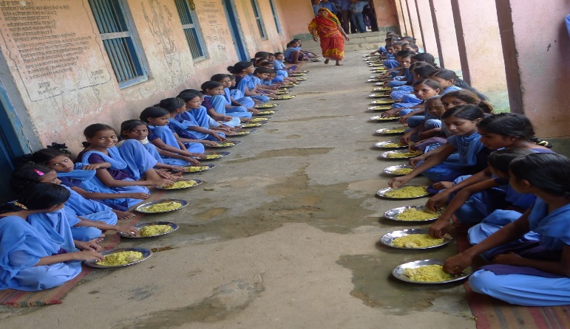
EDUCATION ACTIVITIES
Block | No. of dropouts enrolled in schools
Kahalgaon | 87
Shahkund | 16
Pirpanti | 31
Sanhaula | 20
Jagdishpur | 110
Total | 264
Name of Block | UNIFORMS | SCHOLRSHIP | CYCLE YOJANA
 | Number of children Benefitted | Number of children Benefitted | Number of children Benefitted
Shahkund | 28263 | 10322 | 433
Kahalgaon | 21570 | 277 | 264
Pirpainti | 23445 | 11106 | 0

Slide 6
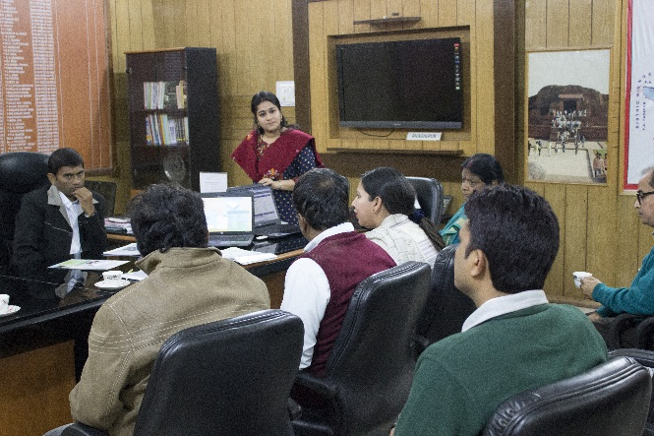
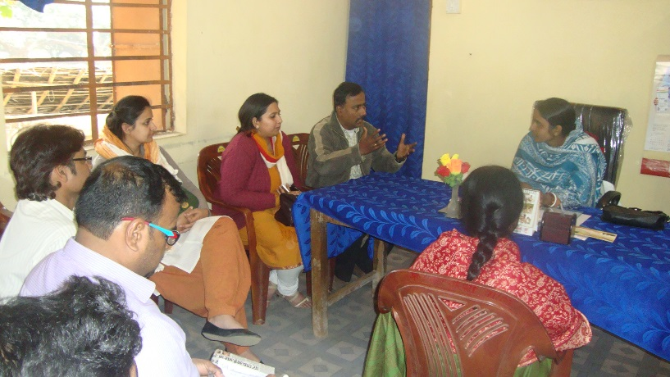
ADVOCACY ACTIVITIES:
We have formed 12 Advocacy Groups in the 12 selected Panchayats in the 5 blocks. These groups have AWWs, ASHAs, ANMs, school teachers, ward members and community members as representatives.
From amongst these Advocacy Groups, AIPAD will form a KshetriyaSamiti at the block level so that the gaps at the block level can be taken up. This will be further led by the Steering Committee at the District level to be headed by the District Magistrate.
Block | Panchayats | Present Strength of the Groups
Shahkund | KishanpurAmkhoriya | 11
Shahkund | Amba | 20
Jagdishpur | Baijani | 11
Jagdishpur | Jamni | 13
Shanhaula | BhuriyaMahimaya | 16
Shanhaula | BadiNaki | 15
Kahalgaon | Antichak | 8
Kahalgaon | Ogri | 17
Kahalgaon | Ghogha | 14
Pirpainti | Rifatpur | 16
Pirpainti | Rajgaon | 16
Pirpainti | Manikpur | 25

Slide 7
CHALLENGES
Departments unofficially set internal % targets for rejection of applications for schemes. This negatively impacts Universalization goals of locations and schemes.
Long duration between filing of application for availing the benefits of the schemes and the actual receipt of the benefits.
Malpractices practiced by the people in the documentation process.
Small errors in ID and address proof (e.g. different parents/guardian/spouse name), difference in DOB and discrepancies in BPL list, lead to many people still being deprived of availing the benefits of the schemes.
Very high rate of attrition amongst the team members in the field due to demographic issues and local environment. Experienced difficulty in recruiting female Project Coordinators

Slide 8
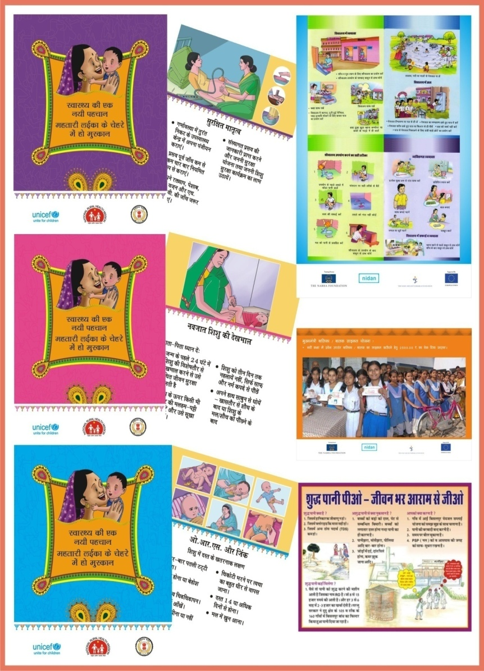
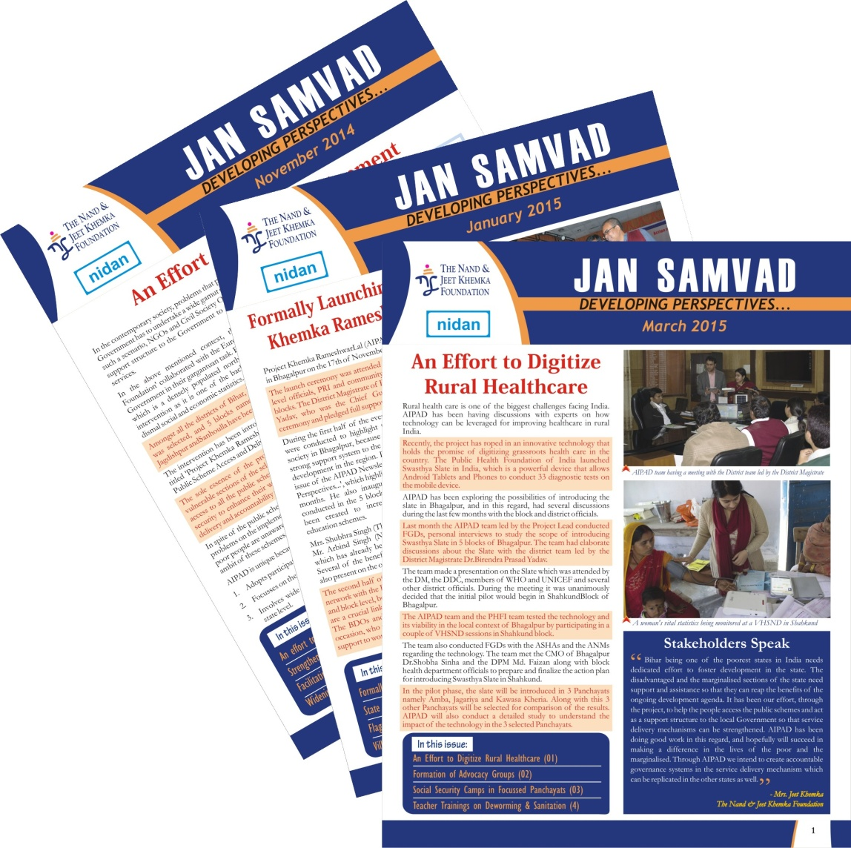
VISIBILITY ACTIVITIES

Slide 9
COLLABORATIONS
SWASTHYA SLATE: AIPAD has roped in an innovative technology called ‘Swasthya Slate’ which holds the promise of digitizing rural healthcare in India. We are planning a pilot with the District health Society, Bhagalpur.
Sharing of best practices, experiences, resources (scheme data base, IEC material etc), ideas on a regular basis. All the 14 partners can create a group to advocate for better services at the district, state and central level.

